Slide 1
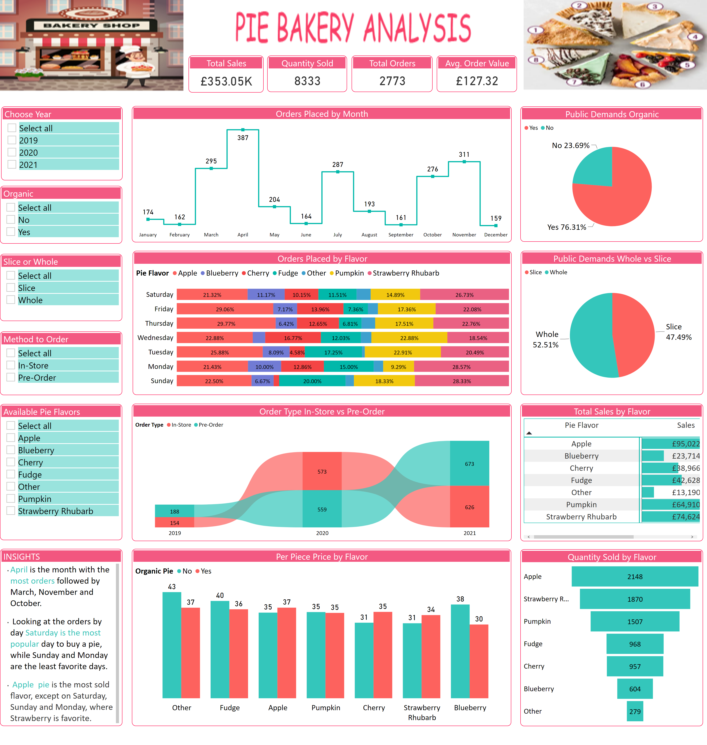
Pie Bakery
Notes:
Organic
No alt text provided
Choose Year
No alt text provided
Available Pie Flavors
No alt text provided
Slice or Whole
No alt text provided
Method to Order
No alt text provided
Total Sales
No alt text provided
Quantity Sold
No alt text provided
Total Orders
No alt text provided
Avg. Order Value
No alt text provided
Orders Placed by Month
No alt text provided
Quantity Sold by Flavor
No alt text provided
INSIGHTS
No alt text provided
Order Type In-Store vs Pre-Order
No alt text provided
Public Demands Organic
No alt text provided
Public Demands Whole vs Slice
No alt text provided
Orders Placed by Flavor
No alt text provided
Per Piece Price by Flavor
No alt text provided
Total Sales by Flavor
No alt text provided

Slide 2



Pie Bakery Analysis
View in Power BI
Last data refresh:
3/15/2022 1:51:47 PM UTC
Downloaded at:
3/15/2022 1:54:11 PM UTC

